Slide 1
Vulnerability Found on http://testasp.vulnweb.com/
The website http://testasp.vulnweb.com/ has an endpoint that is vulnerable to an injection vulnerability - namely a reflected injection of JavaScript, also known as Reflected Cross Site Scripting (XSS).
As per OWASP's definition: "Cross-Site Scripting (XSS) attacks are a type of injection, in which malicious scripts are injected into otherwise benign and trusted websites. " This happens because one of the GET parameters "p" does not properly sanitize/escape user input, allowing an injection to occur.

Slide 2
Steps To Reproduce:
To reproduce this, an attacker has to:
Prepare a Javascript payload that it wants the victim to execute. In this case, for Proof of Concept purposes, our Javascript code will prompt an alert showing the number.
The Payload I injected here is <script>alert(1)</script>
And inject it in the search for post section/page.
You will be prompted with the alert
With this bug we can gather many information about the website.

Slide 3
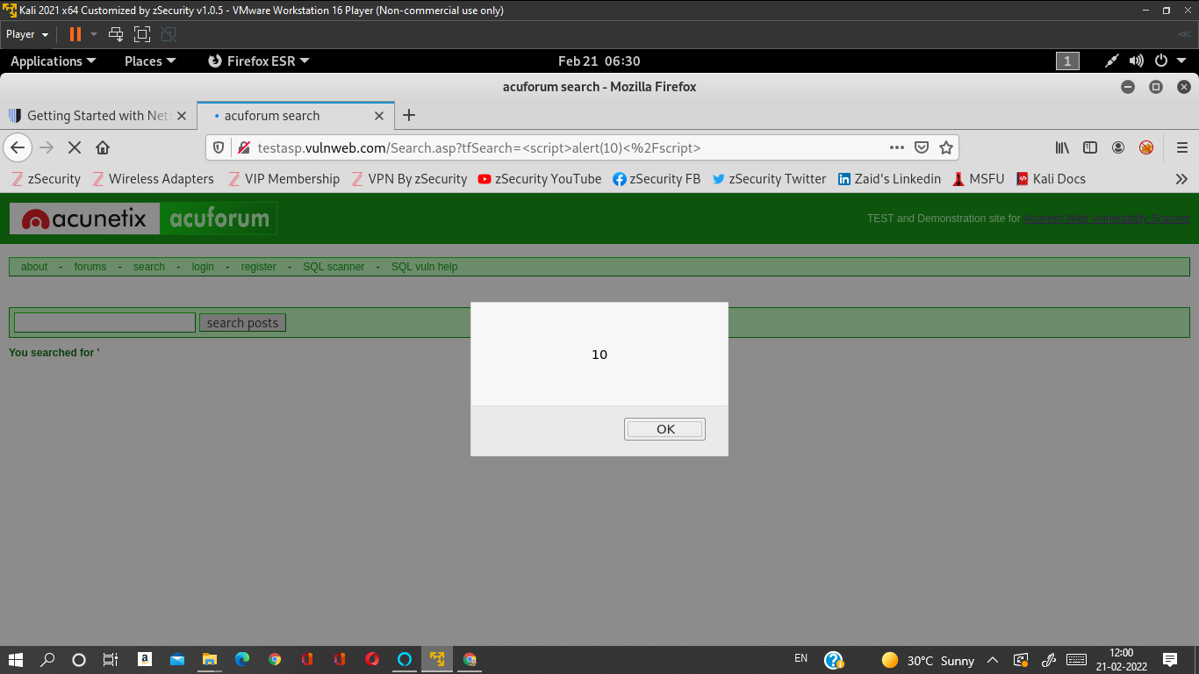
ScreenShots

Slide 4

Video of Proof

